Slide 1
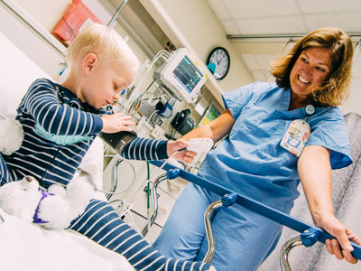
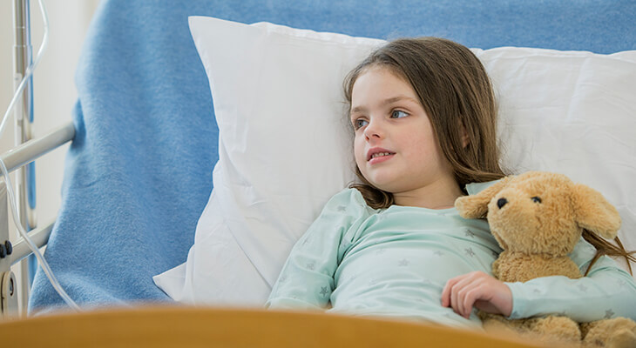
THE EFFECT OF AUGMENTED REALITY TECHNOLOGY ON PREOPERATİVE ANXIETY IN CHILDREN AND PARENTS
Zeynep Şule EVREN
Bezmialem Vakıf University, Faculty of Medicine /5th Grade
Mentor: Dr. İbrahim Aydoğdu

Slide 2
PLAN
Augmented Reality
Introduction
Inclusion Exclusion Criteria
Material Method
Results
Conclusion

Slide 3
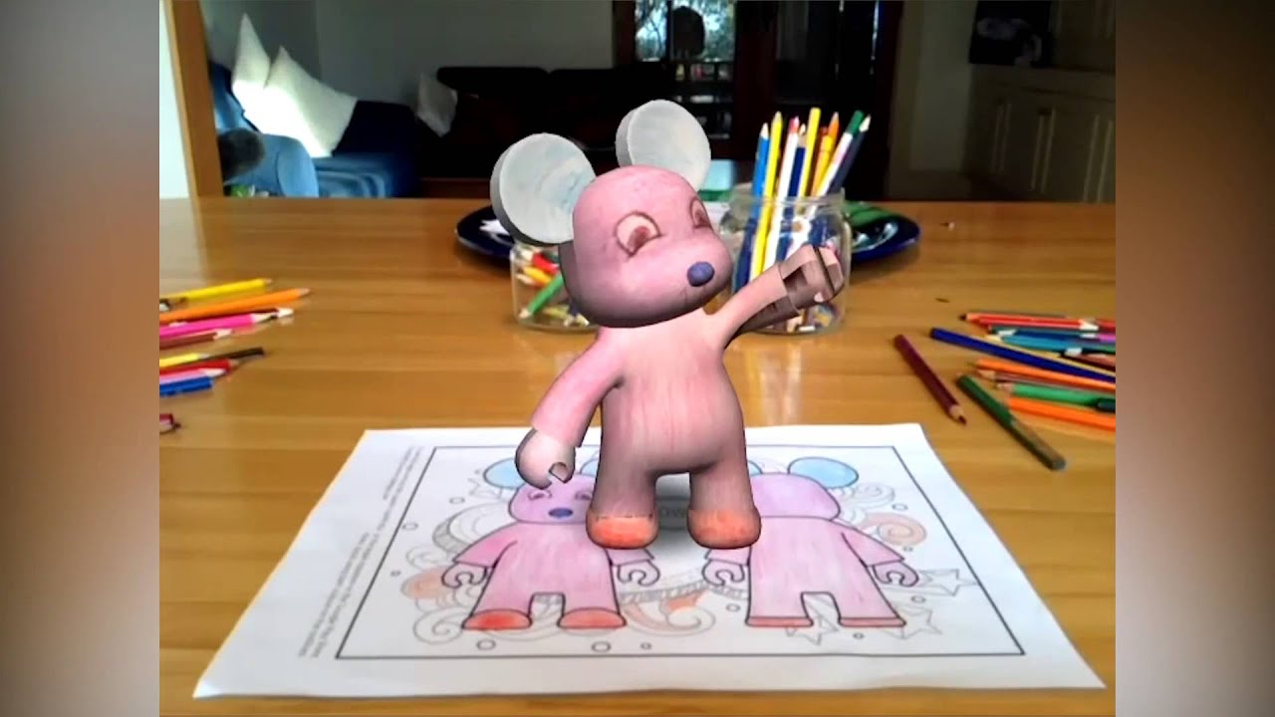
Augmented Reality:
It allows the child to see what they paint in three-dimension with the help of a phone or tablet computer after painting.
https://www.youtube.com/watch?v=tBYm53L79YY

Slide 4
INTRODUCTION
Surgical procedures can often cause serious anxiety and stress in children and their families.
OBJECTIVE: To reveal whether "augmented reality" has a significant contribution in reducing preoperative anxiety in children and to examine whether it is also effective on parents.

Slide 5
INCLUSION AND EXCLUSION CRITERIA
Inclusion Criteria
The family must sign the informed consent form.
The children to undergo the surgery must be between the ages 4-11.
Exclusion Criteria
Since cortisol levels will be measured;
Having a chronic illness
Using cortisol for any reason

Slide 6
MATERIAL-METHOD
Our study is a prospective study.
2 groups were formed.
Scales used:
1) For kids: mYPAS(Modified Yale Preoperatif Anxiety Scale)
2) For parents: STAI (State-Trait Anxiety Inventory)
- Before the operation; Saliva samples were taken for cortisol analysis before and after the distraction.

Slide 7
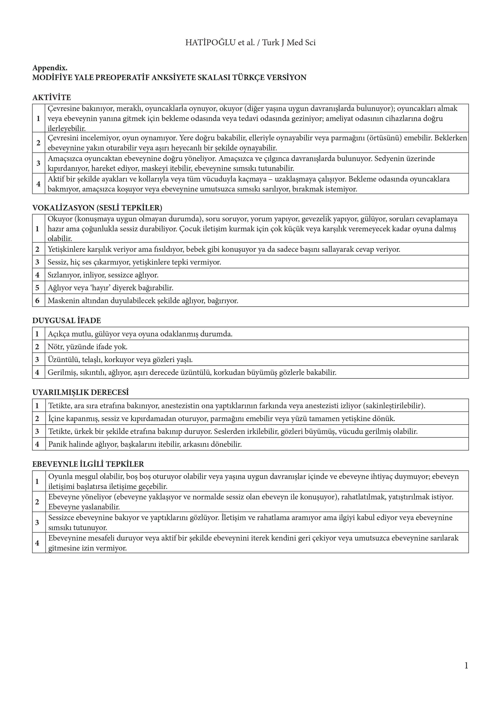

Slide 8
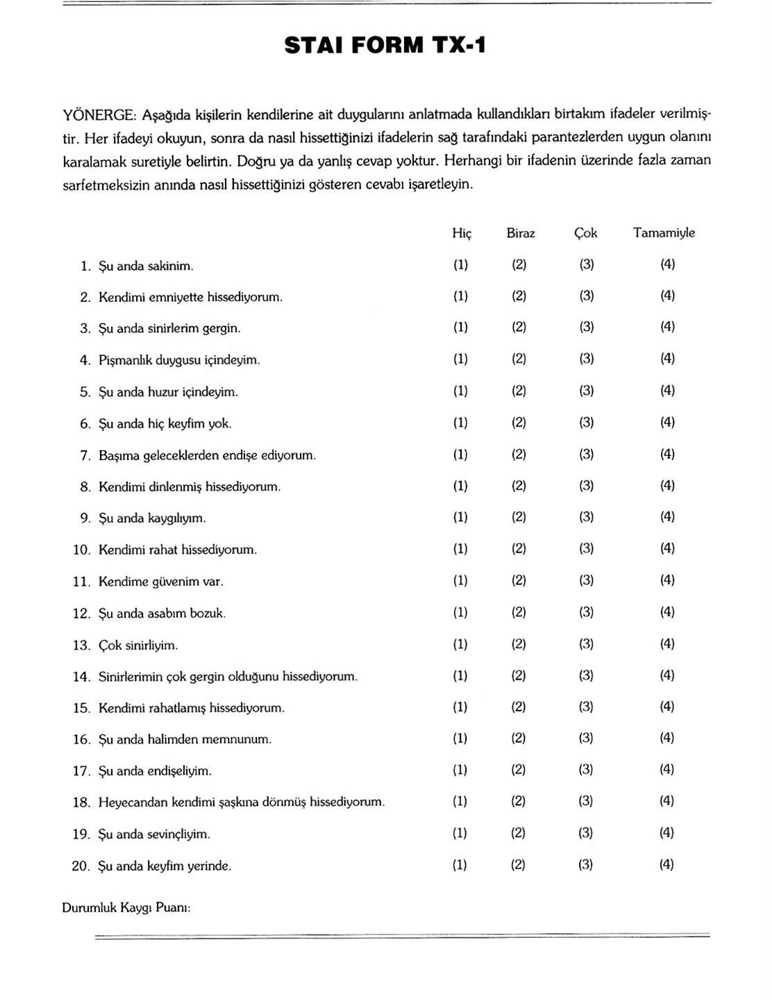
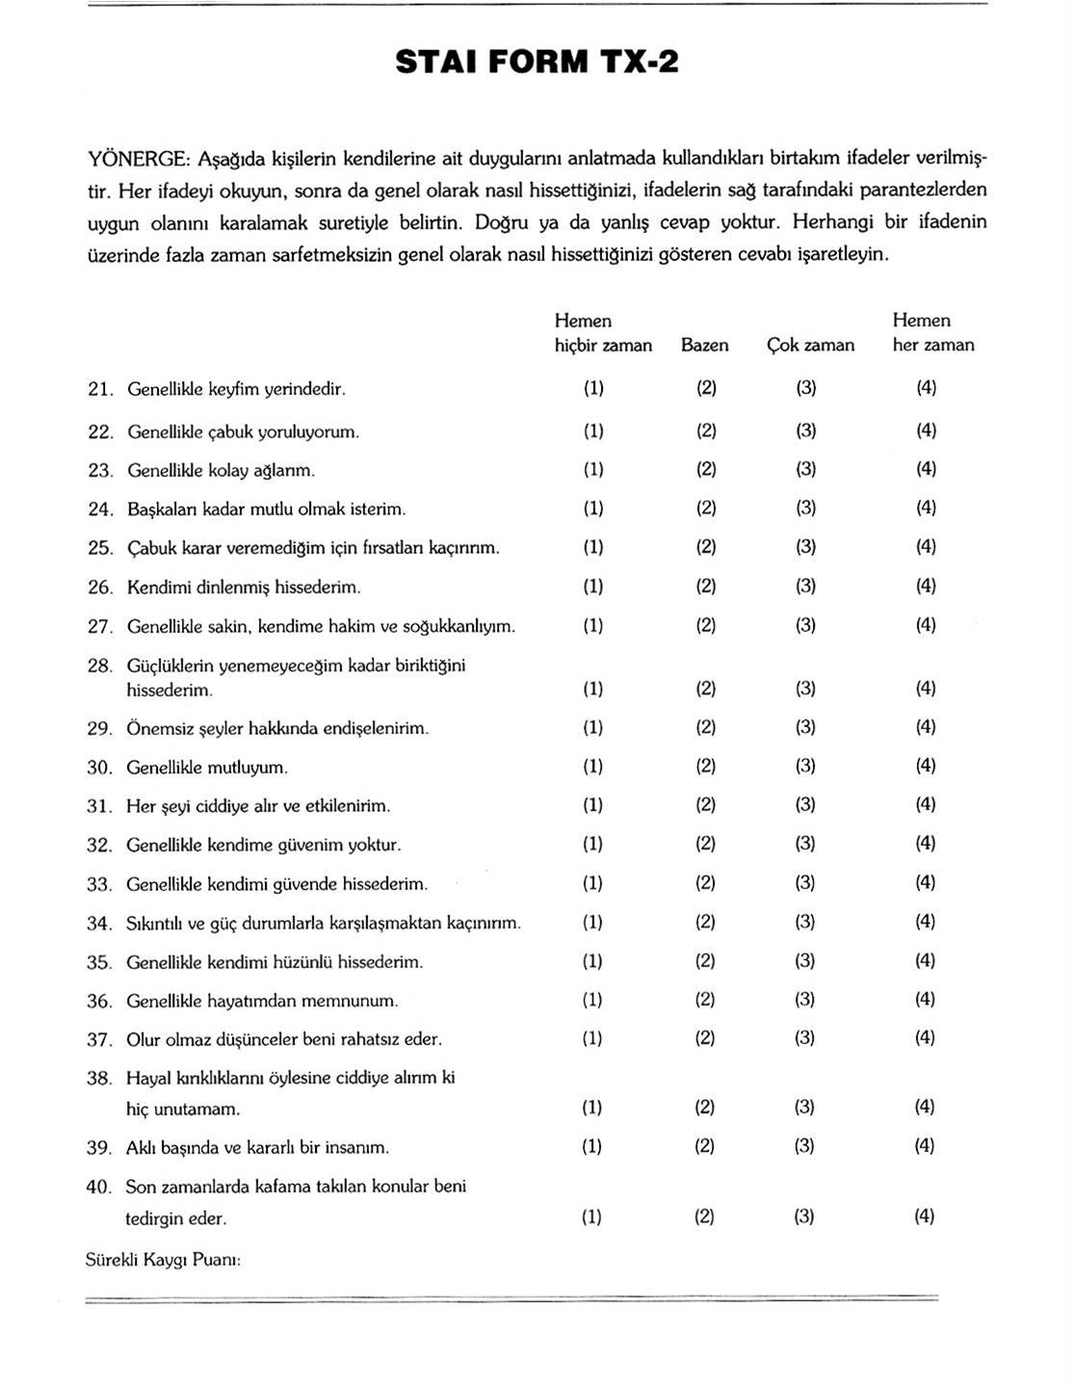

Slide 9
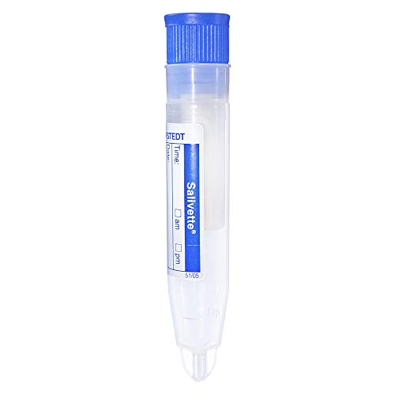
Cortisol Measurements
Saliva samples were taken before and after application.
It is stated in the literature that salivary cortisol is superior to serum cortisol in stress measurement.
These samples has been analyzed by Chemiluminescence method.
Djordje Bozovic1,Maja Racic2, Nedeljka Ivkovic1, Salivary Cortisol Levels as a
Biological Marker of Stress Reaction, Med Arch. 2013;67(5):374-7.

Slide 10
Study Group (n=18)
Painting + 3D vision
Control Group (n=21)
No painting and 3D
1) Saliva samples were taken before and after the application
2) After the application, the children were evaluated with the mYPAS.
3) After the application, the parents were evaluated with the STAI.
1)Saliva samples were taken.
2) Children were evaluated with the mYPAS.
3) Parents were evaluated with the STAI.

Slide 11
RESULTS
STUDY GROUP
18 CHİLDREN
CONTROL GROUP
21 CHİLDREN
15 BOY (83,3%)
3 GİRL (16,7%)
Mean age: 6,8±1,7
19 BOY (90,5%)
2 GİRL (9,5%)
Mean Age: 7,2 ±2,7
MYPAS Median:5
Minimum:5, maximum:8
(p<0,05)
STAI: 37,66 (p>0,05)
MYPAS median:6
Minimum:5, maximum: 17
(p<0,05)
STAI:40,09 (p>0,05)

Slide 12
CORTİSOL LEVELS
P=0.011
Study Group
Control Group

Slide 13
CONCLUSİON:
The fact that in the study group the stress level was found to be significantly less with the mYPAS compared to the control group, and the salivary cortisol level significantly decreased showed that use of augmented reality technology could reduce children's anxiety preoperatively.

Slide 14
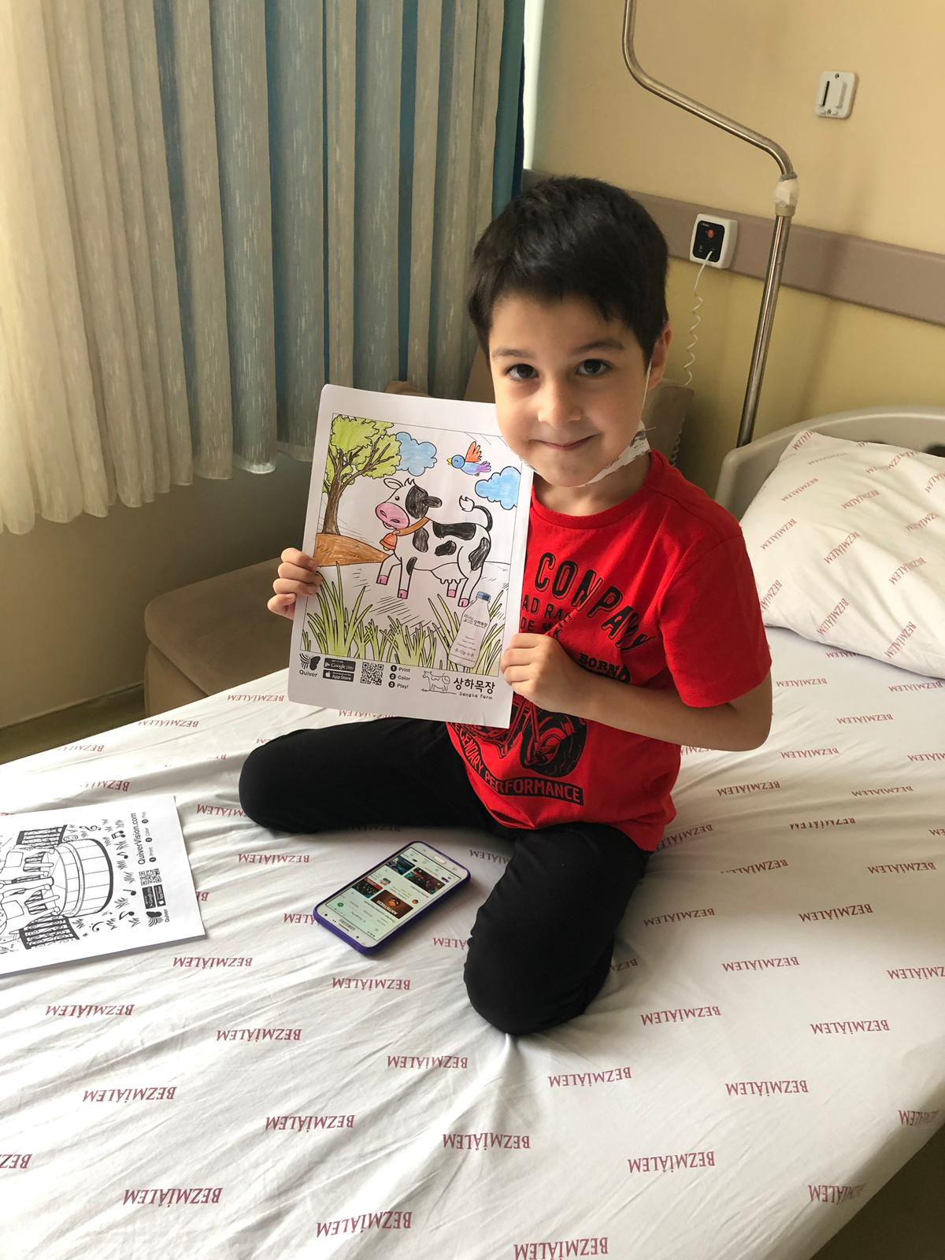
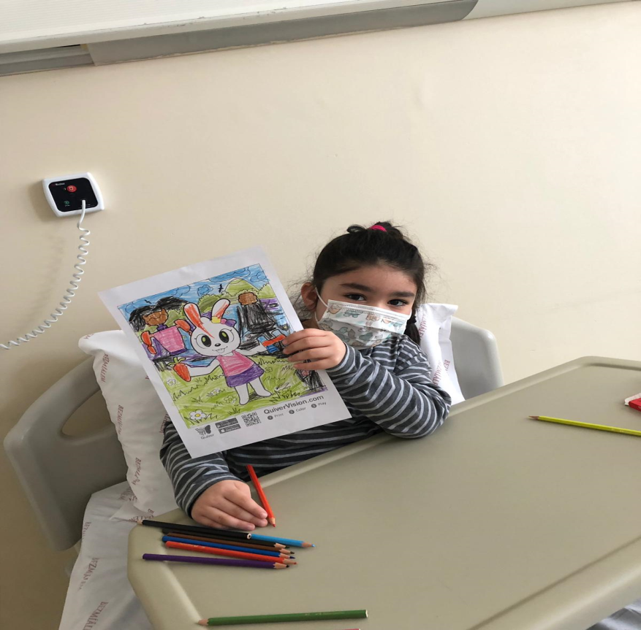
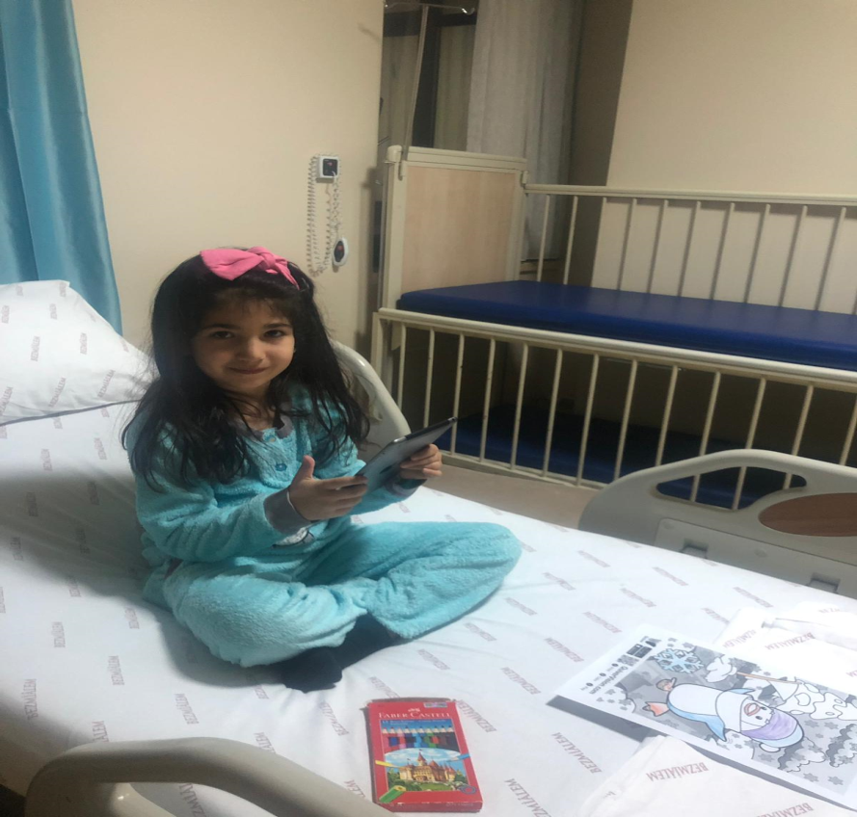
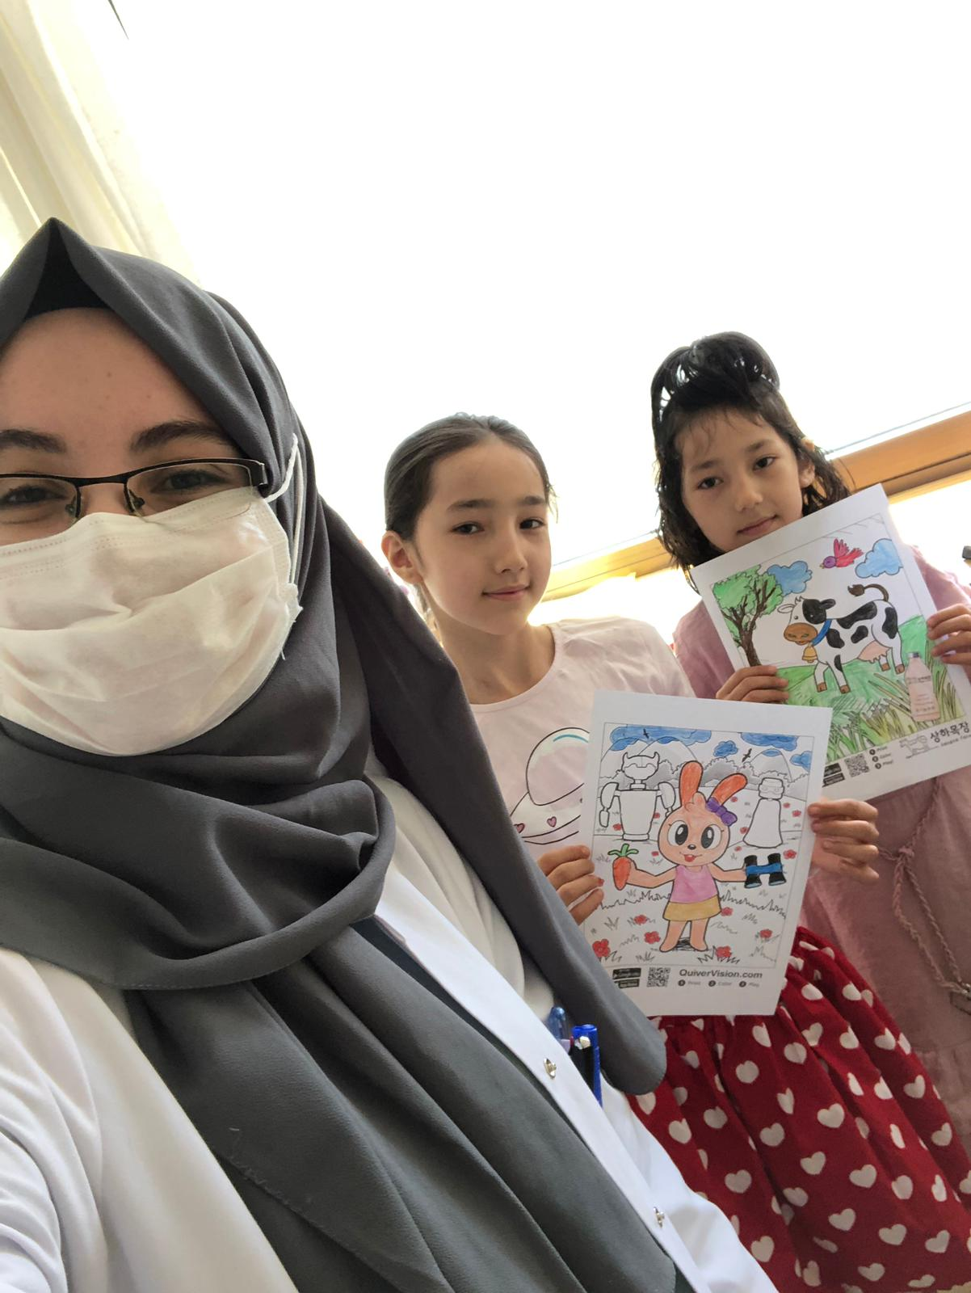

Slide 15
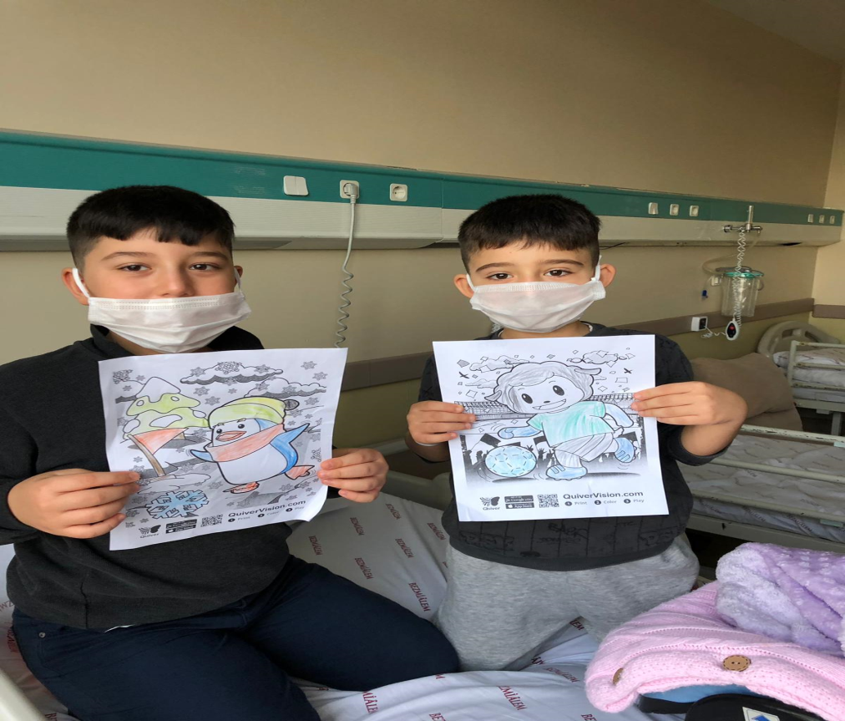
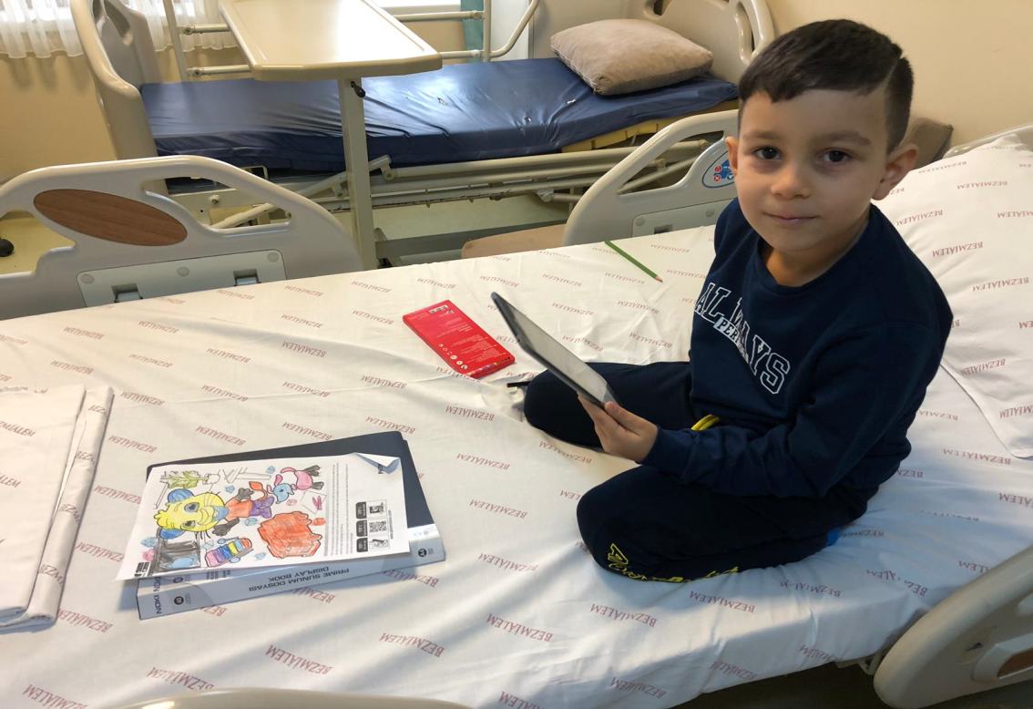
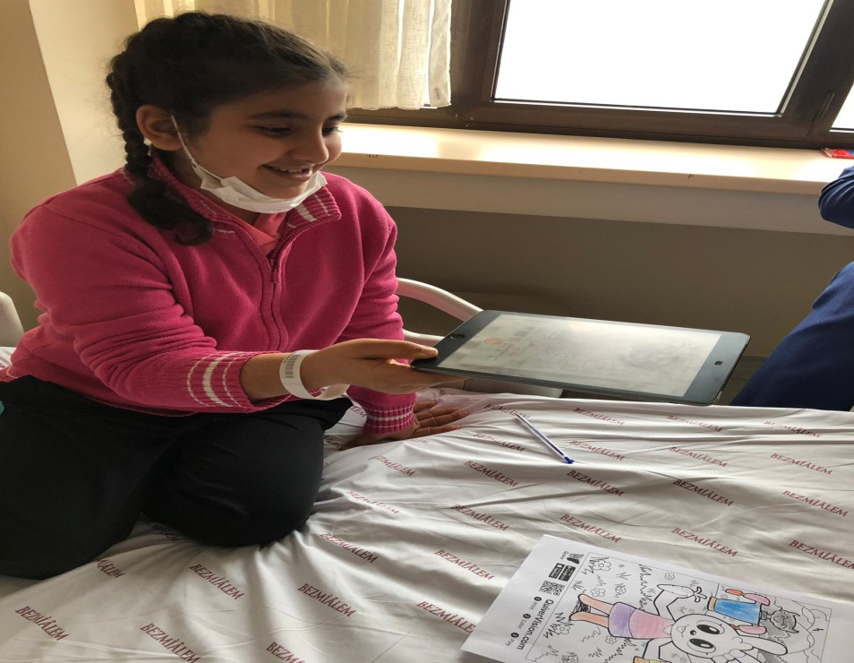
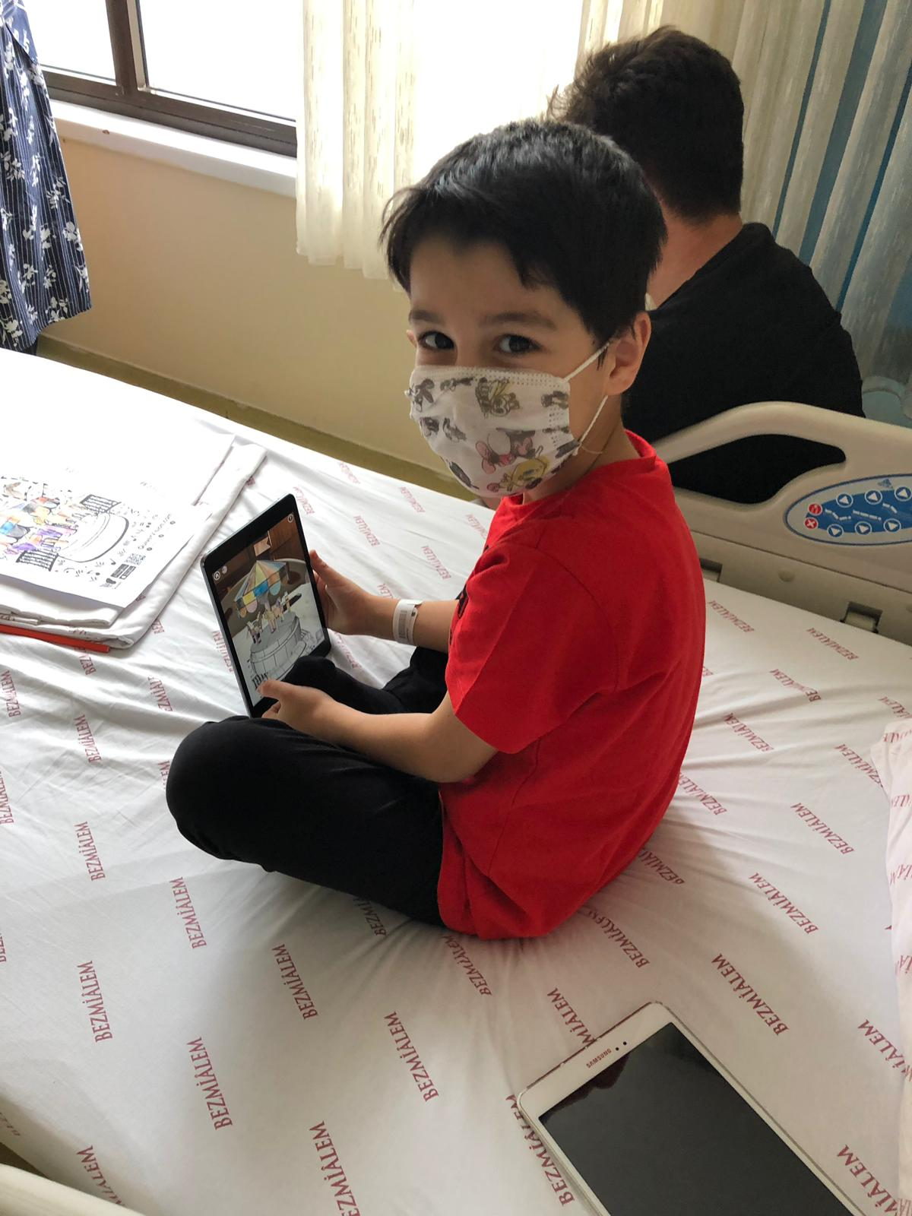

Slide 16
1. Chow CH, Van Lieshout RJ, Schmidt LA, Dobson KG, Buckley N. Systematic
review: audiovisual interventions for reducing preoperative anxiety in children
undergoing elective surgery. J Pediatr Psychol. 2015;41(2):182–203.
doi:10.1093/jpepsy/jsv094.
2. Van der Heijden M JE, Oliai Araghi S, van Dijk M, Jeekel J, Hunink M G. The
effects of perioperative music interventions in pediatric surgery: a systematic
review and meta-analysis of randomized controlled trials. PLoS One.
2015;10(08):e0133608.
3. Felder-Puig R, Maksys A, Noestlinger C, Gadner H, Stark H, Pfluegler A, Topf R.
Using a children&#39;s book to prepare children and parents for elective ENT surgery:
results of a randomized clinical trial. Int J Pediatr Otorhinolaryngol. 2003
Jan;67(1):35-41.
4. Dehghan F, Jalali R, Bashiri H. The effect of virtual reality technology on
preoperative anxiety in children: a Solomon four-group randomized clinical trial.
Perioper Med (Lond). 2019 Jun 4;8:5.
5. Altay N, Kilicarslan-Toruner E, Sari Ç. The effect of drawing and writing
technique on the anxiety level of children undergoing cancer treatment. Eur J
Oncol Nurs. 2017 Jun;28:1-6. doi: 10.1016/j.ejon.
6. Nilsson E, Svensson G, Frisman GH. Picture book support for preparing children
ahead of and during day surgery. Nurs Child Young People. 2016 Oct 7;28(8):30-
35.
7. Scheel T, Hoeppner D, Grotevendt A, Barthlen W. Clowns in Paediatric Surgery:
Less Anxiety and More Oxytocin? A Pilot Study. Klin Padiatr. 2017
Sep;229(5):274-280.
8. Vagnoli L, Caprilli S, Robiglio A, Messeri A. Clown doctors as a treatment for
preoperative anxiety in children: a randomized, prospective study. Pediatrics. 2005
Oct;116(4):e563-7.
9. Patel A, Schieble T, Davidson M, Tran MC, Schoenberg C, Delphin E, Bennett H.
Distraction with a hand-held video game reduces pediatric preoperative anxiety.
Paediatr Anaesth. 2006 Oct;16(10):1019-27.
10. Wennström B, Törnhage CJ, Hedelin H, Nasic S, Bergh I. Child drawings and
salivary cortisol in children undergoing preoperative procedures associated with
day surgery. J Perianesth Nurs. 2013 Dec;28(6):361-7
11. Dağlı S.,Demirci M.,Kavalcı A.,Kol N., Şahin E.,Uyanık E., Günübirlik Cerrahi
Geçirecek Çocukların ve Ailelerinin Ameliyat Hakkında Bilgilendirilmesinin
Preoperatif Anksiyete ve Postoperatif Davranış Değişiklikleri Üzerine Olan
Etkileri. Journal of Anesthesia, 2016 1(24), 13,17.
12. Aytekin A, Doru Ö, Kucukoglu S. The Effects of Distraction on Preoperative
Anxiety Level in Children. J Perianesth Nurs. 2016 Feb;31(1):56-62
13. Djordje Bozovic1,Maja Racic2, Nedeljka Ivkovic1, Salivary Cortisol Levels as a
Biological Marker of Stress Reaction, Med Arch. 2013;67(5):374-7.
References:
1. Chow CH, Van Lieshout RJ, Schmidt LA, Dobson KG, Buckley N. Systematic
review: audiovisual interventions for reducing preoperative anxiety in children
undergoing elective surgery. J Pediatr Psychol. 2015;41(2):182–203.
doi:10.1093/jpepsy/jsv094.
2. Van der Heijden M JE, Oliai Araghi S, van Dijk M, Jeekel J, Hunink M G. The
effects of perioperative music interventions in pediatric surgery: a systematic
review and meta-analysis of randomized controlled trials. PLoS One.
2015;10(08):e0133608.
3. Felder-Puig R, Maksys A, Noestlinger C, Gadner H, Stark H, Pfluegler A, Topf R.
Using a children&#39;s book to prepare children and parents for elective ENT surgery:
results of a randomized clinical trial. Int J Pediatr Otorhinolaryngol. 2003
Jan;67(1):35-41.
4. Dehghan F, Jalali R, Bashiri H. The effect of virtual reality technology on
preoperative anxiety in children: a Solomon four-group randomized clinical trial.
Perioper Med (Lond). 2019 Jun 4;8:5.

Slide 17
5. Altay N, Kilicarslan-Toruner E, Sari Ç. The effect of drawing and writing
technique on the anxiety level of children undergoing cancer treatment. Eur J
Oncol Nurs. 2017 Jun;28:1-6. doi: 10.1016/j.ejon.
6. Nilsson E, Svensson G, Frisman GH. Picture book support for preparing children
ahead of and during day surgery. Nurs Child Young People. 2016 Oct 7;28(8):30-
35.
7. Scheel T, Hoeppner D, Grotevendt A, Barthlen W. Clowns in Paediatric Surgery:
Less Anxiety and More Oxytocin? A Pilot Study. Klin Padiatr. 2017
Sep;229(5):274-280.
8. Vagnoli L, Caprilli S, Robiglio A, Messeri A. Clown doctors as a treatment for
preoperative anxiety in children: a randomized, prospective study. Pediatrics. 2005
Oct;116(4):e563-7.
9. Patel A, Schieble T, Davidson M, Tran MC, Schoenberg C, Delphin E, Bennett H.
Distraction with a hand-held video game reduces pediatric preoperative anxiety.
Paediatr Anaesth. 2006 Oct;16(10):1019-27.
10. Wennström B, Törnhage CJ, Hedelin H, Nasic S, Bergh I. Child drawings and
salivary cortisol in children undergoing preoperative procedures associated with
day surgery. J Perianesth Nurs. 2013 Dec;28(6):361-7

Slide 18
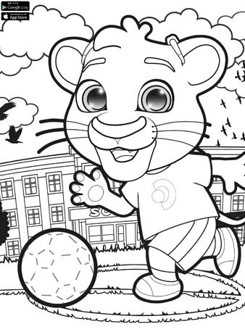
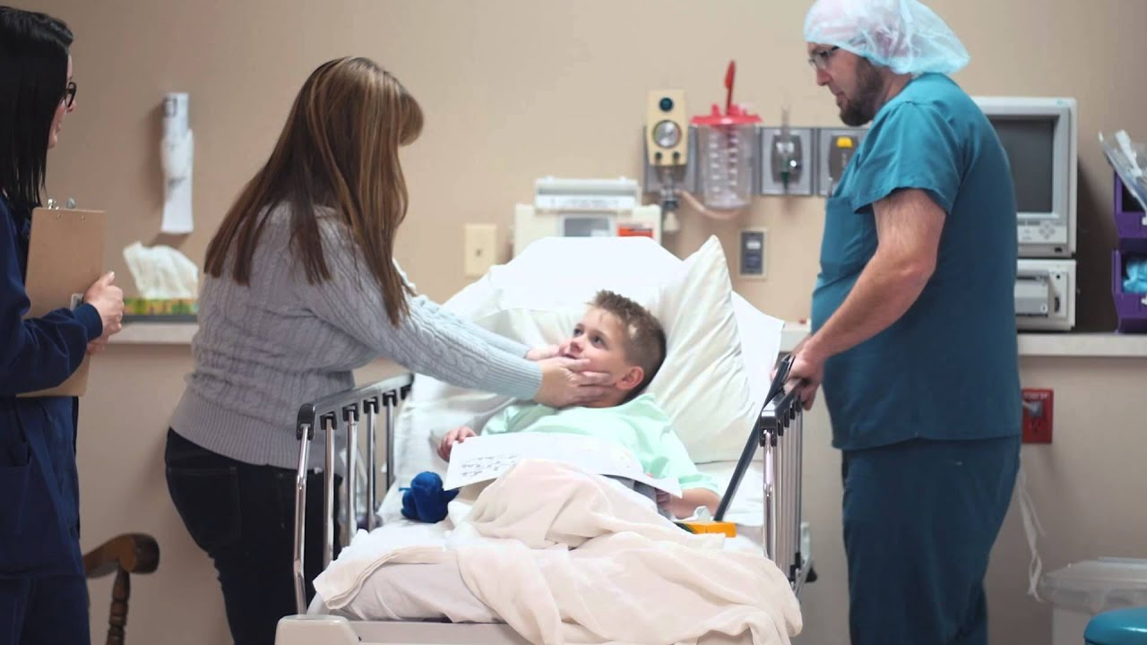
THANK YOU
11. Dağlı S.,Demirci M.,Kavalcı A.,Kol N., Şahin E.,Uyanık E., Günübirlik Cerrahi
Geçirecek Çocukların ve Ailelerinin Ameliyat Hakkında Bilgilendirilmesinin
Preoperatif Anksiyete ve Postoperatif Davranış Değişiklikleri Üzerine Olan
Etkileri. Journal of Anesthesia, 2016 1(24), 13,17.
12. Aytekin A, Doru Ö, Kucukoglu S. The Effects of Distraction on Preoperative
Anxiety Level in Children. J Perianesth Nurs. 2016 Feb;31(1):56-62
13. Djordje Bozovic1,Maja Racic2, Nedeljka Ivkovic1, Salivary Cortisol Levels as a
Biological Marker of Stress Reaction, Med Arch. 2013;67(5):374-7.

